Slide 1












Slide 2





Slide 3








Slide 4






16-26

Slide 5












Slide 6







Slide 7
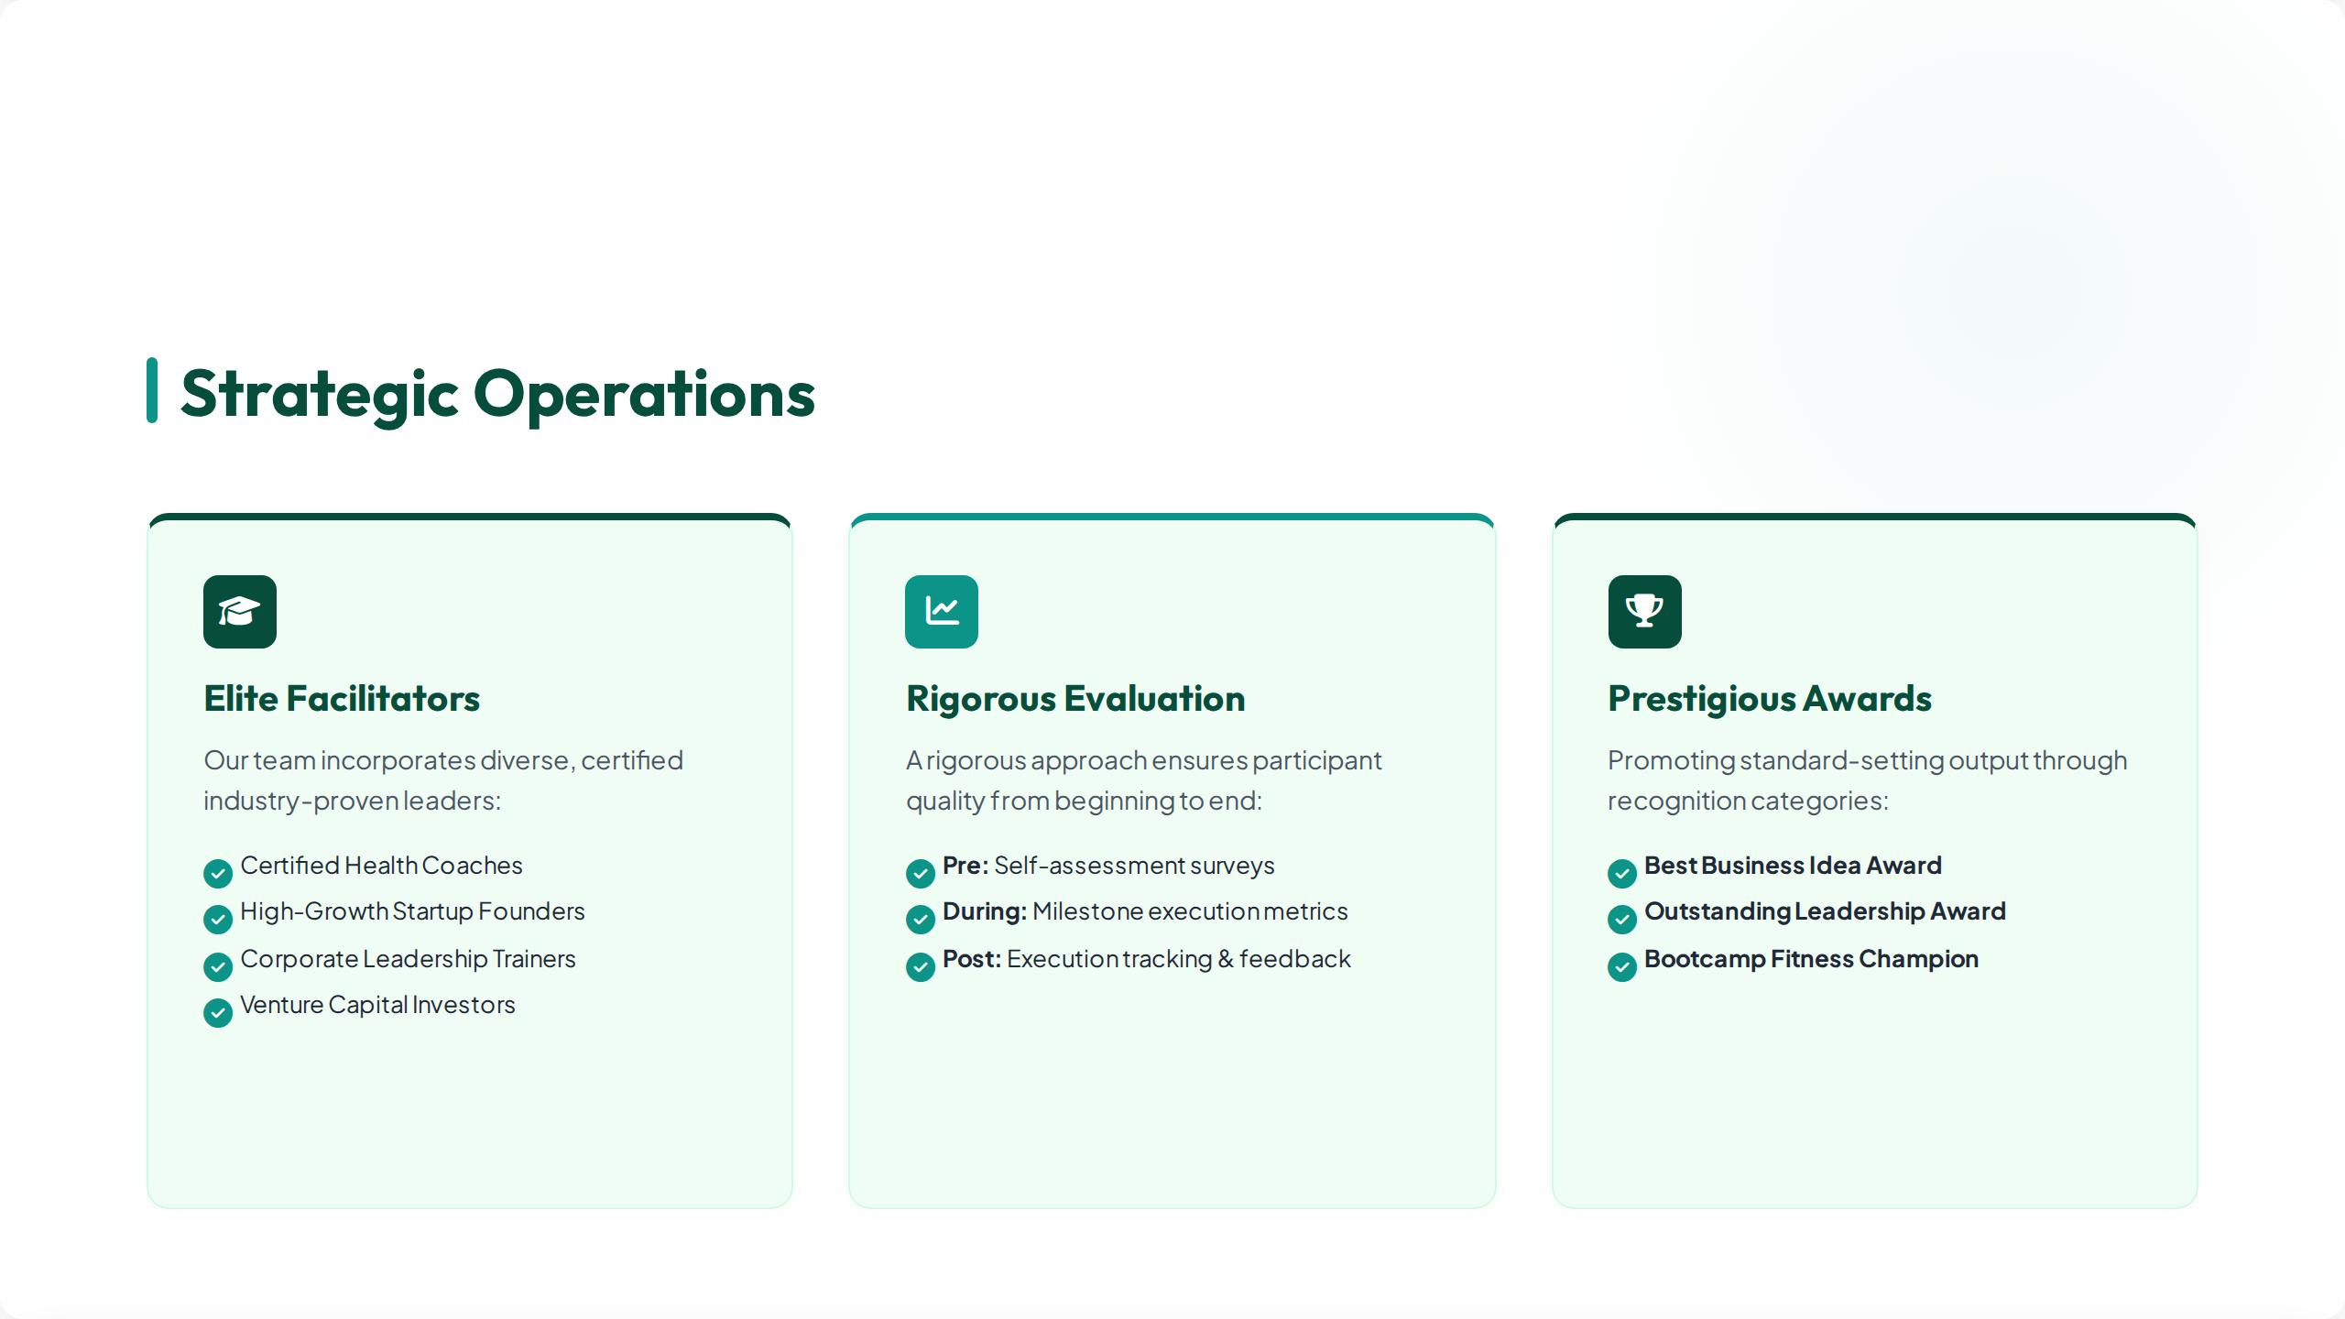





Slide 8


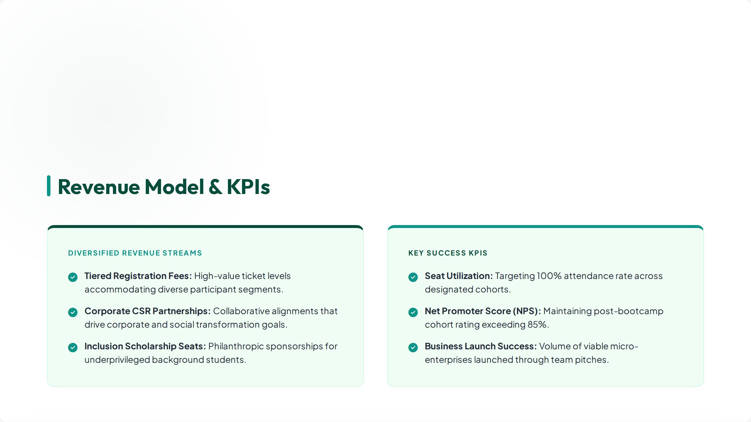

Slide 9










Slide 10






Slide 11





CONTACT US
PHONE: (92) 334 801 2345
EMAIL info@ahmadshahzadfoundation.org

